Slide 1
Malignant Comments Classifier
SUBMITTED BY :-PRATIK KUMAR

Slide 2
Problem Statement
Our goal is to build a prototype of online hate and abuse comment classifier which can used to classify hate and offensive comments so that it can be controlled and restricted from spreading hatred and cyberbullying.

Slide 3
Multi –Label Classification Problem
Difference between multi-class classification & multi-label classification is that in multi-class problems the classes are mutually exclusive, whereas for multi-label problems each label represents a different classification task, but the tasks are somehow related.
For example, multi-class classification makes the assumption that each sample is assigned to one and only one label: a fruit can be either an apple or a pear but not both at the same time. Whereas, an instance of multi-label classification can be that a text might be about any of religion, politics, finance or education at the same time or none of these.

Slide 4
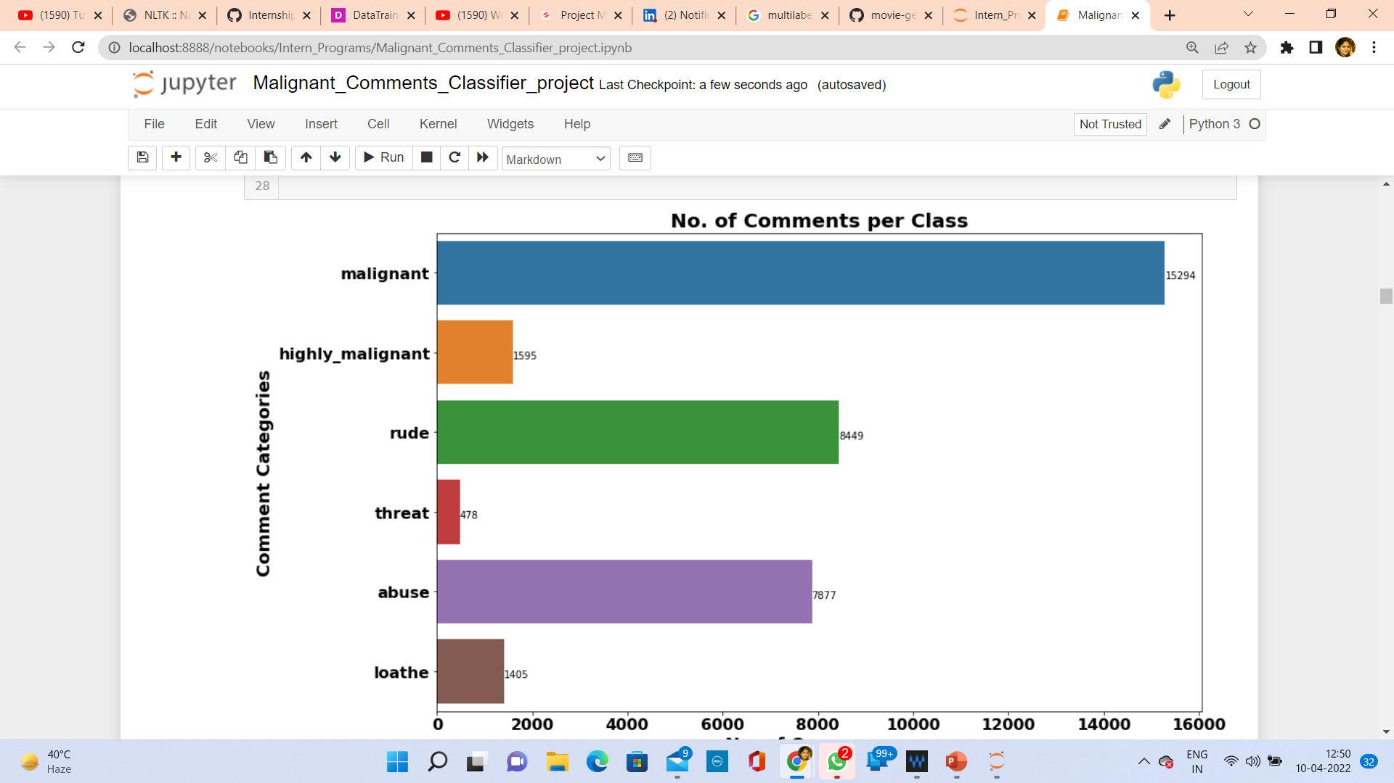
Exploration of Target Variable Ratings
Out of total Negative comments the maximum negative comments come with Malignant in nature followed by rude categories.
Around 90% comments are Good/Neutral in nature while rest 10% comments are Negative in nature.
Very few comments come with threatening nature.

Slide 5
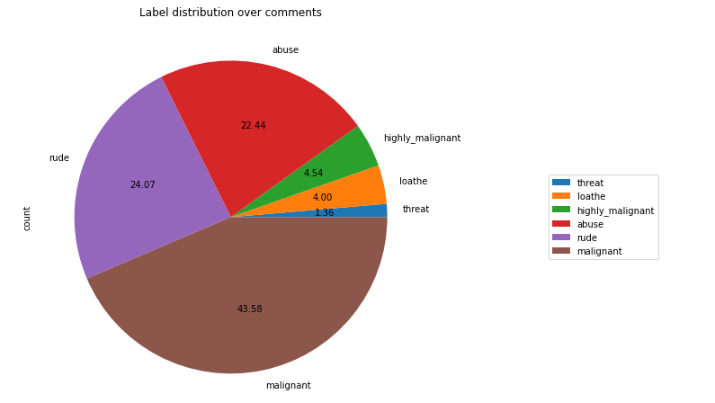
Out of total negative comments around 43.58% are malignant in nature followed by 24.07% are rude comments

Slide 6
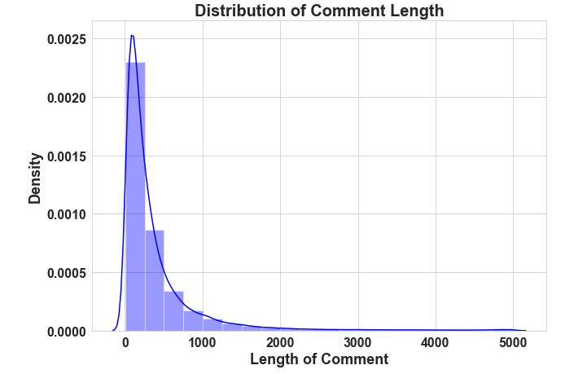
Above is a plot showing the comment length frequency. As noticed, most of the comments are short with only a few comments longer than 1000 words.
Majority of the comments are of length 500, where maximum length is 5000 and minimum length is 5. Median length being 250.

Slide 7
Data Pre Processing
Convert the text to lowercase
Remove the punctuations, digits and special characters
Tokenize the text, filter out the adjectives used in the review and create a new column in data frame
Remove the stop words
Stemming and Lemmatising
Applying Text Vectorization to convert text into numeric

Slide 8
Word Cloud for getting word sense
Word Cloud is a visualization technique for text data wherein each word is picturized with its importance in the context or its frequency.
The more commonly the term appears within the text being analysed, the larger the word appears in the image generated.
The enlarged texts are the greatest number of words used there and small texts are the smaller number of words used.

Slide 9
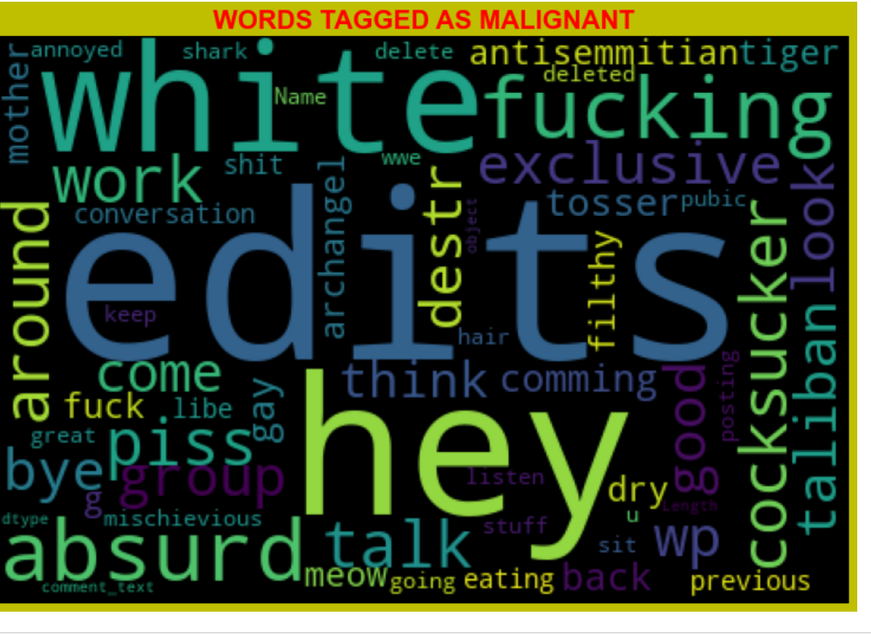
From word cloud of malignant comments, it is clear that it mostly consists of words like edits, hey, absurd,white, fucking, gay, cocksucker, work, piss, think, Taliban etc

Slide 10
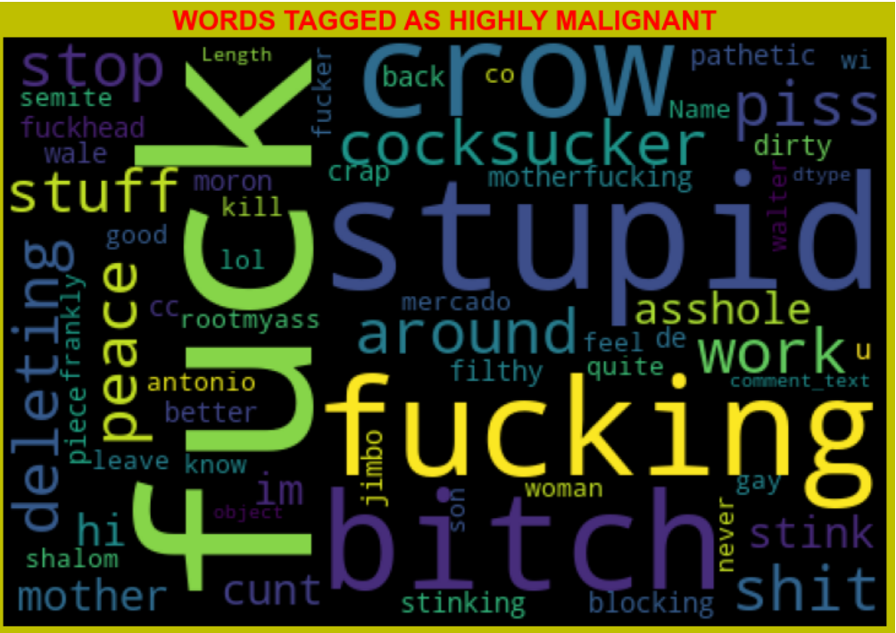
From word cloud of Highly malignant comments, it is clear that it mostly consists of words like fuck, stupid, fucking, bitch, crow, shit, cocksucker etc

Slide 11
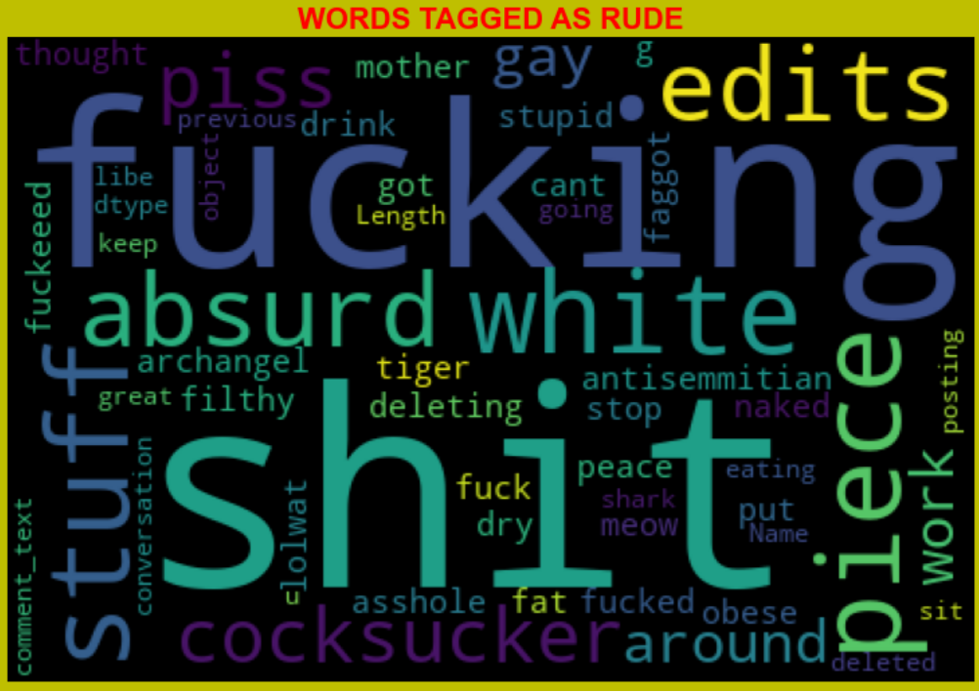
From word cloud of Rude comments, it is clear that it mostly consists of words like fucking, shit, white, absurd, piece, edits, stuff, absurd etc.

Slide 12
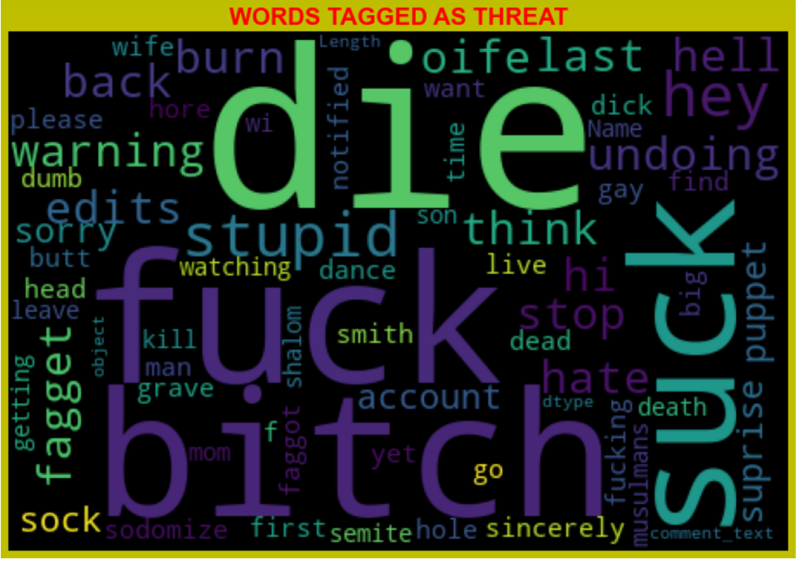
From word cloud of Threat comments, it is clear that it mostly consists of words like fuck, suck, Bitch, die, stupid, warning etc.

Slide 13
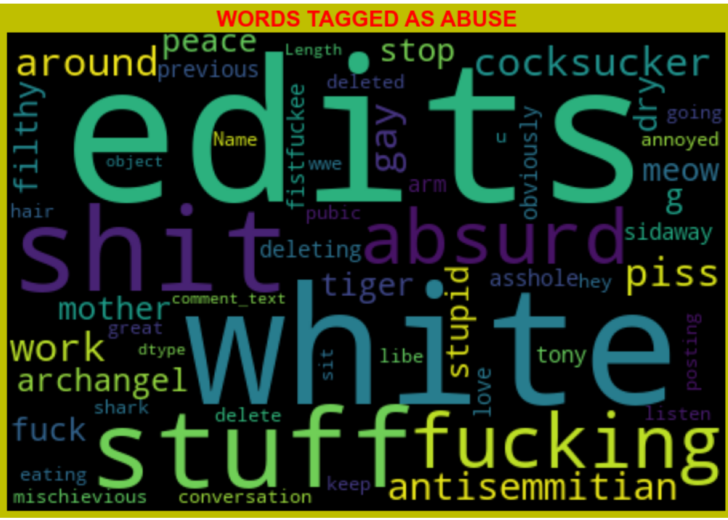
From word cloud of Abuse comments, it is clear that it mostly consists of words like edits, white, shit, stuff, fuck, piss, fucking etc.

Slide 14
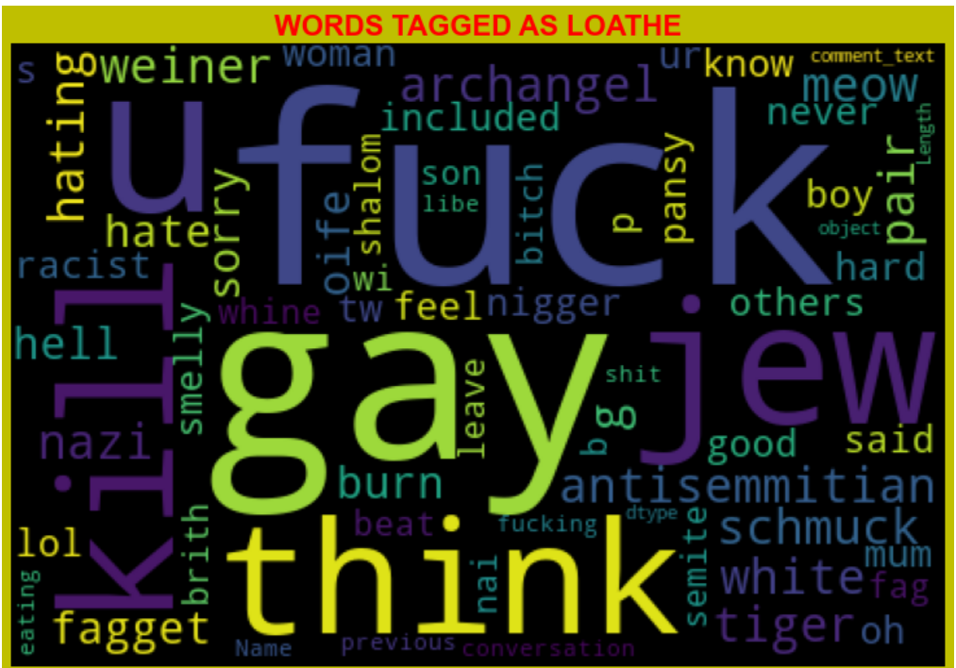
From word cloud of Loathe comments, it is clear that it mostly consists of words like fuck, gay, kill, think, jew, u etc.

Slide 15
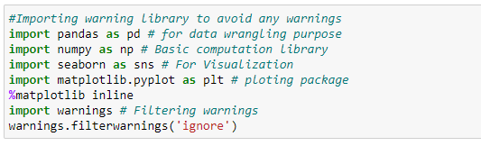
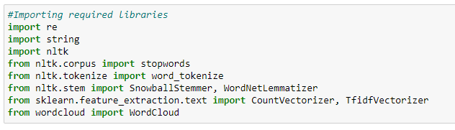
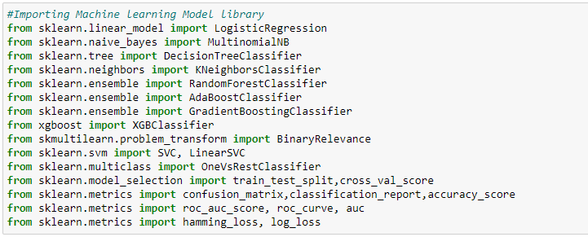
Visualization & Data Wrangling Library used
Text Mining Library used
Machine Learning Model Building Library used

Slide 16
Machine Learning Model Building
The different classification algorithm used in this project to build ML model are as below:
Random Forest classifier
Support Vector Classifier
Logistics Regression
AdaBoost Classifier

Slide 17
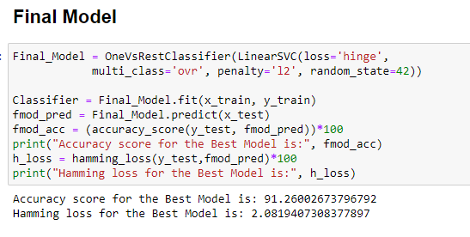
Final ML Model
Final Model is giving us Accuracy score of 91.26% which is slightly improved compare to earlier Accuracy score of 91.15%.

Slide 18
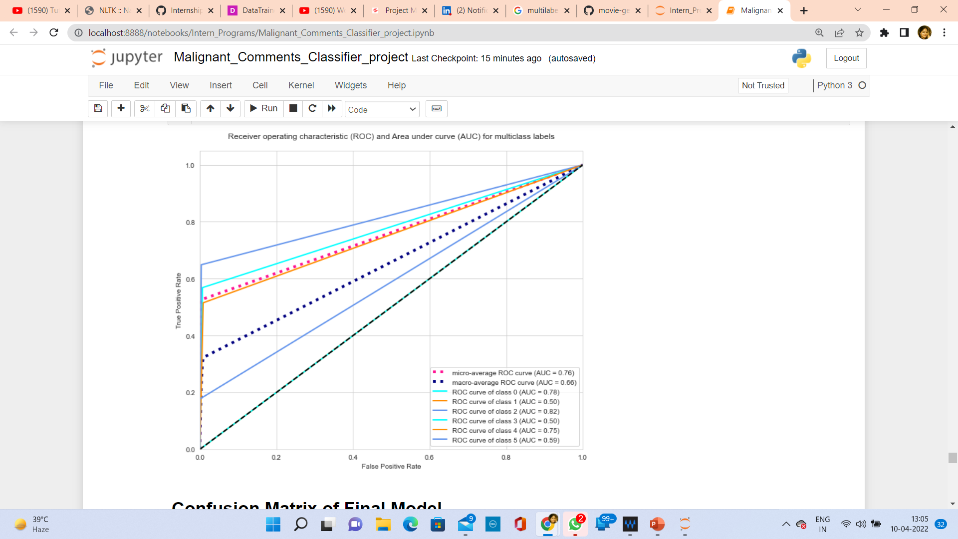
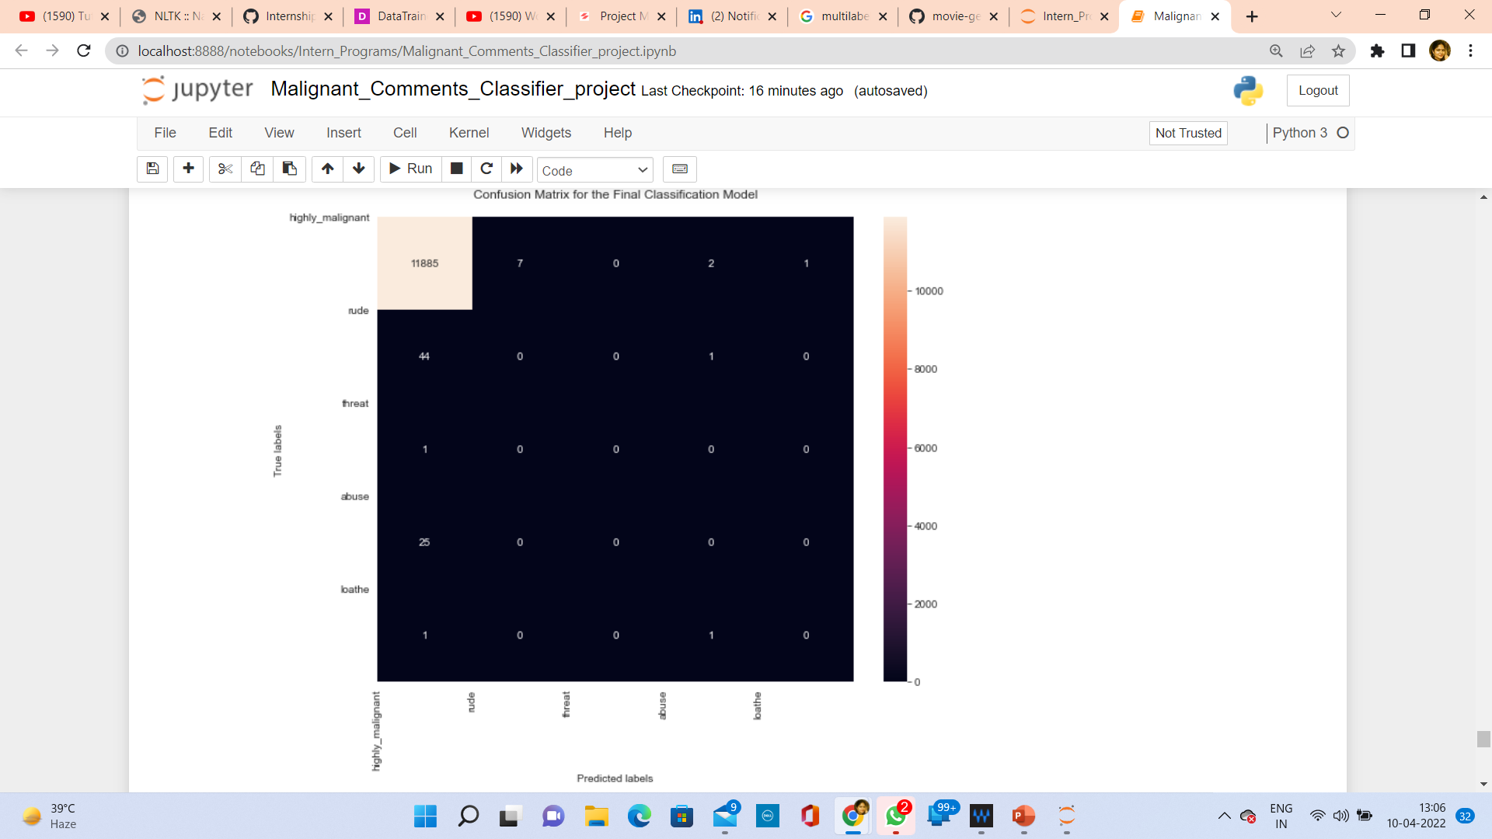
AOC-ROC Curve & Confusion Matrix

Slide 19
CONCLUSION
Linear Support Vector Classifier performs better with Accuracy Score: 91.2 % and Hamming Loss: 2.09 % than the other classification models.
Final Model (Hyperparameter Tuning) is giving us Accuracy score of 91.26% which is slightly improved compare to earlier Accuracy score of 91.15%.
SVM classifier is fastest algorithm compare to others.

